Slide 1
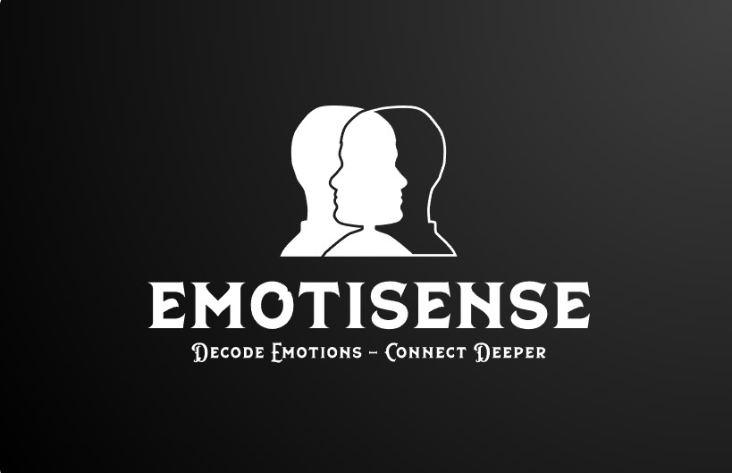
EmotiSense
Atmakuri Krishnasai Bharadwaj
Mohammadreza Akbari Lor
Mohitha Dayana
Hema Nagini Matta
A Multi-Modal Emotion Detection Framework

Slide 2
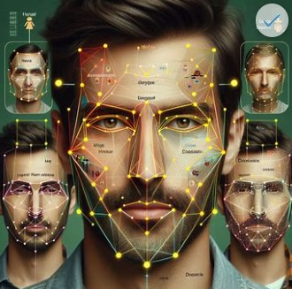
Motive
EmotiSense can be used is in online education. EmotiSense can help teachers monitor and improve student engagement, motivation, and learning outcomes by providing real-time feedback and personalized interventions based on their emotional states. For example, EmotiSense can analyze the text, speech, and face cues of the students during a live or recorded lecture, and identify their emotions, such as boredom, confusion, interest, or frustration. Based on this information, EmotiSense can suggest the teacher to adjust the pace, difficulty, or style of the lecture, or to provide more examples, quizzes, or feedback to the students. EmotiSense can also help students develop their emotional intelligence and self-regulation skills by reflecting on their own emotions and learning strategies, and by offering them emotional support and guidance.

Slide 3


Intro
Emotions are essential to human nature. We use different ways to show our feelings, such as our faces, voices, words, or pictures.
Machines can help us understand emotions.
They can also mimic emotions to interact better with us.

Slide 4
How many facets of human emotions are essential for authentic communication with the rest of the world?

Slide 5
Just one! Your own.
With a little help from our EmotiSense Product

Slide 6
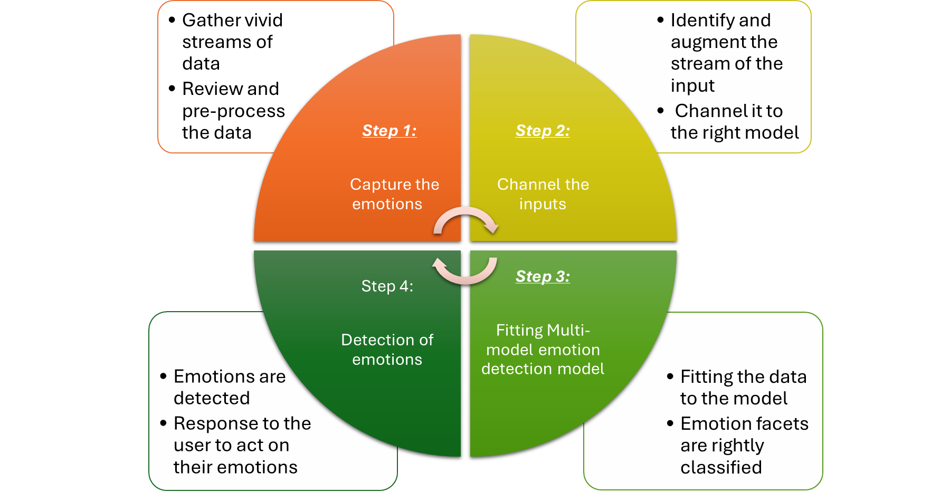
EmotiSense Product Flow

Slide 7
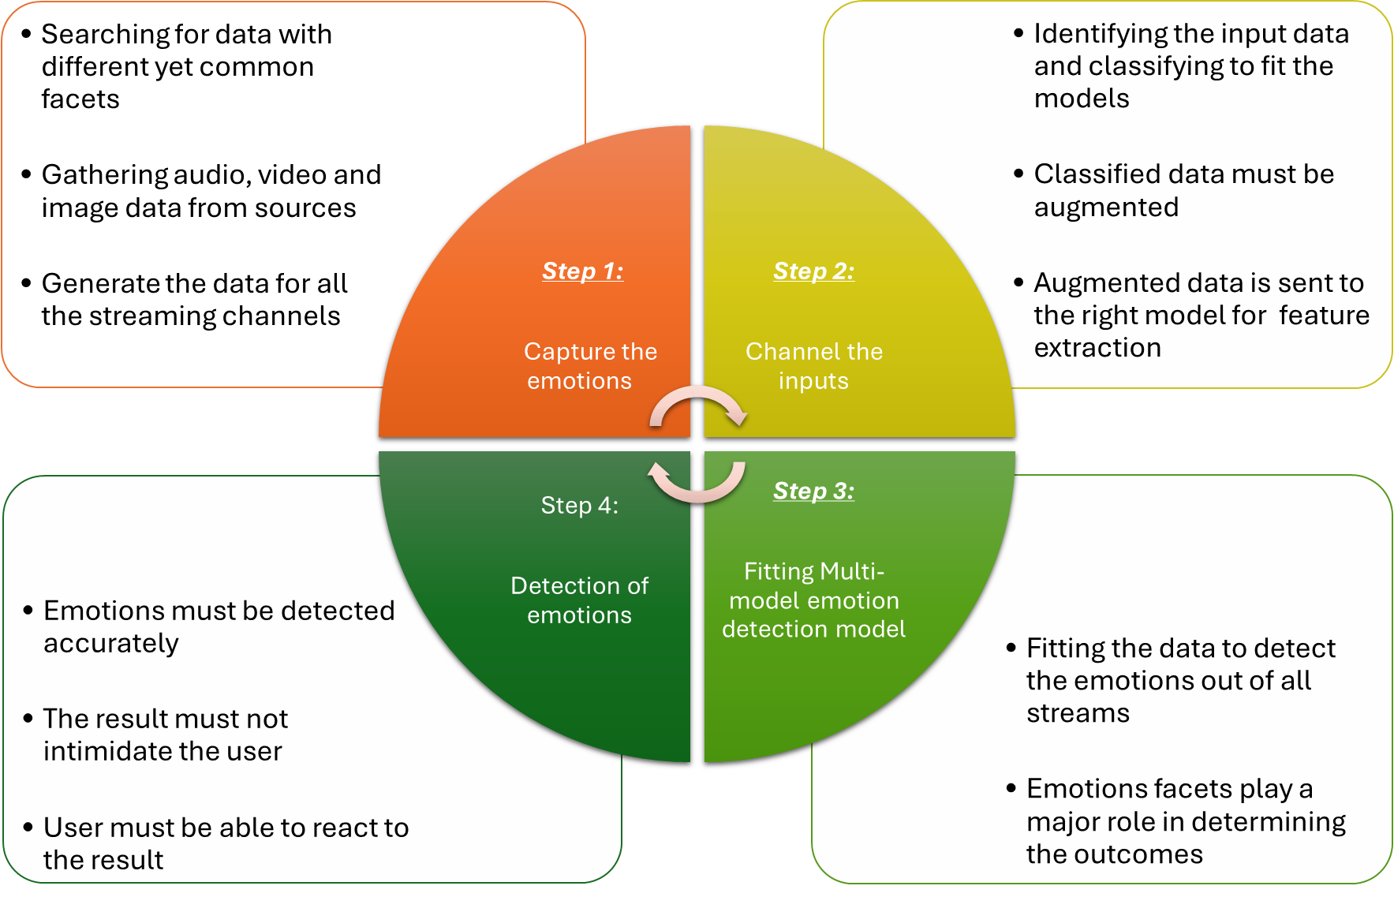
EmotiSense - Challenges

Slide 8
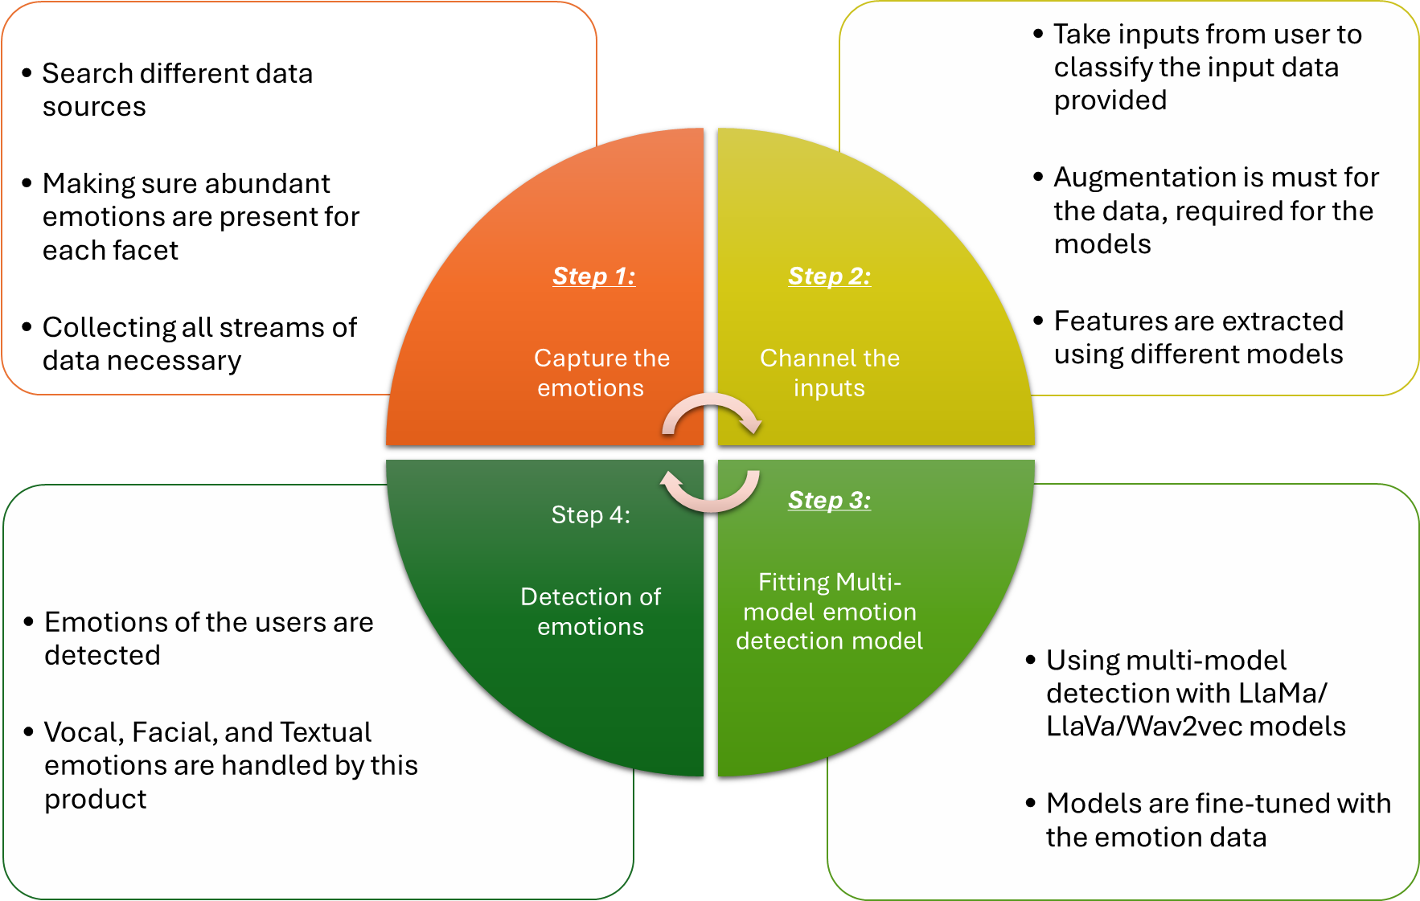
EmotiSense - Solution

Slide 9
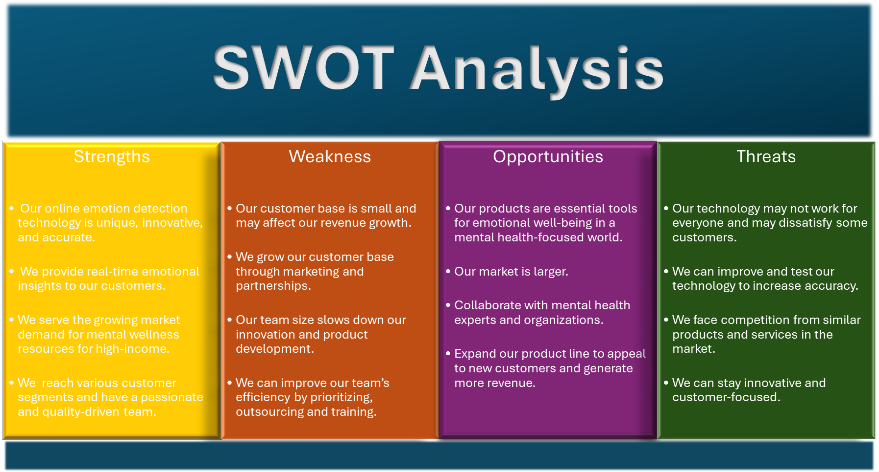

Slide 10
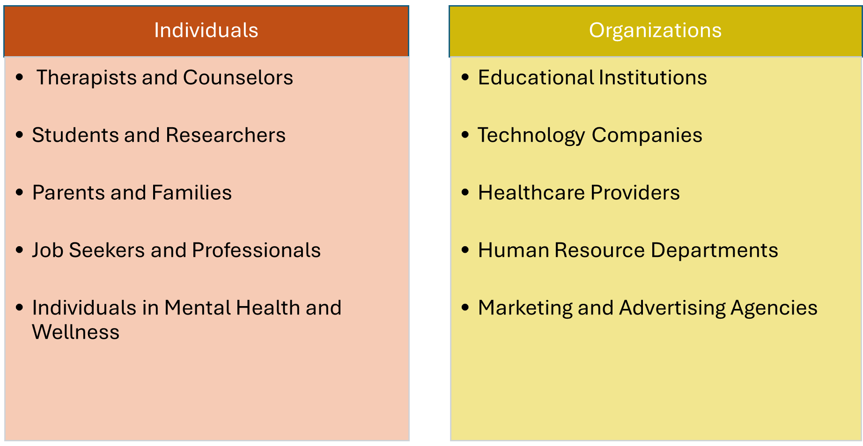
Potential Customer Base

Slide 11
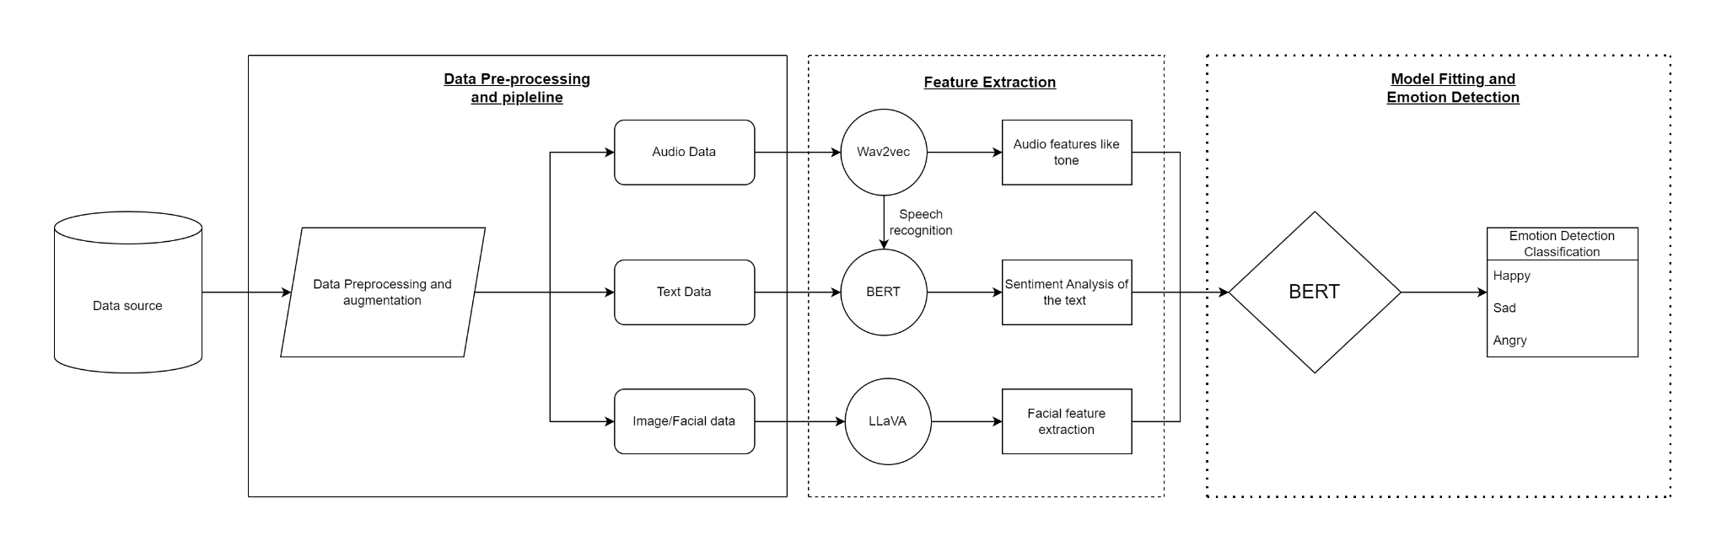
Conceptual Diagram

Slide 12
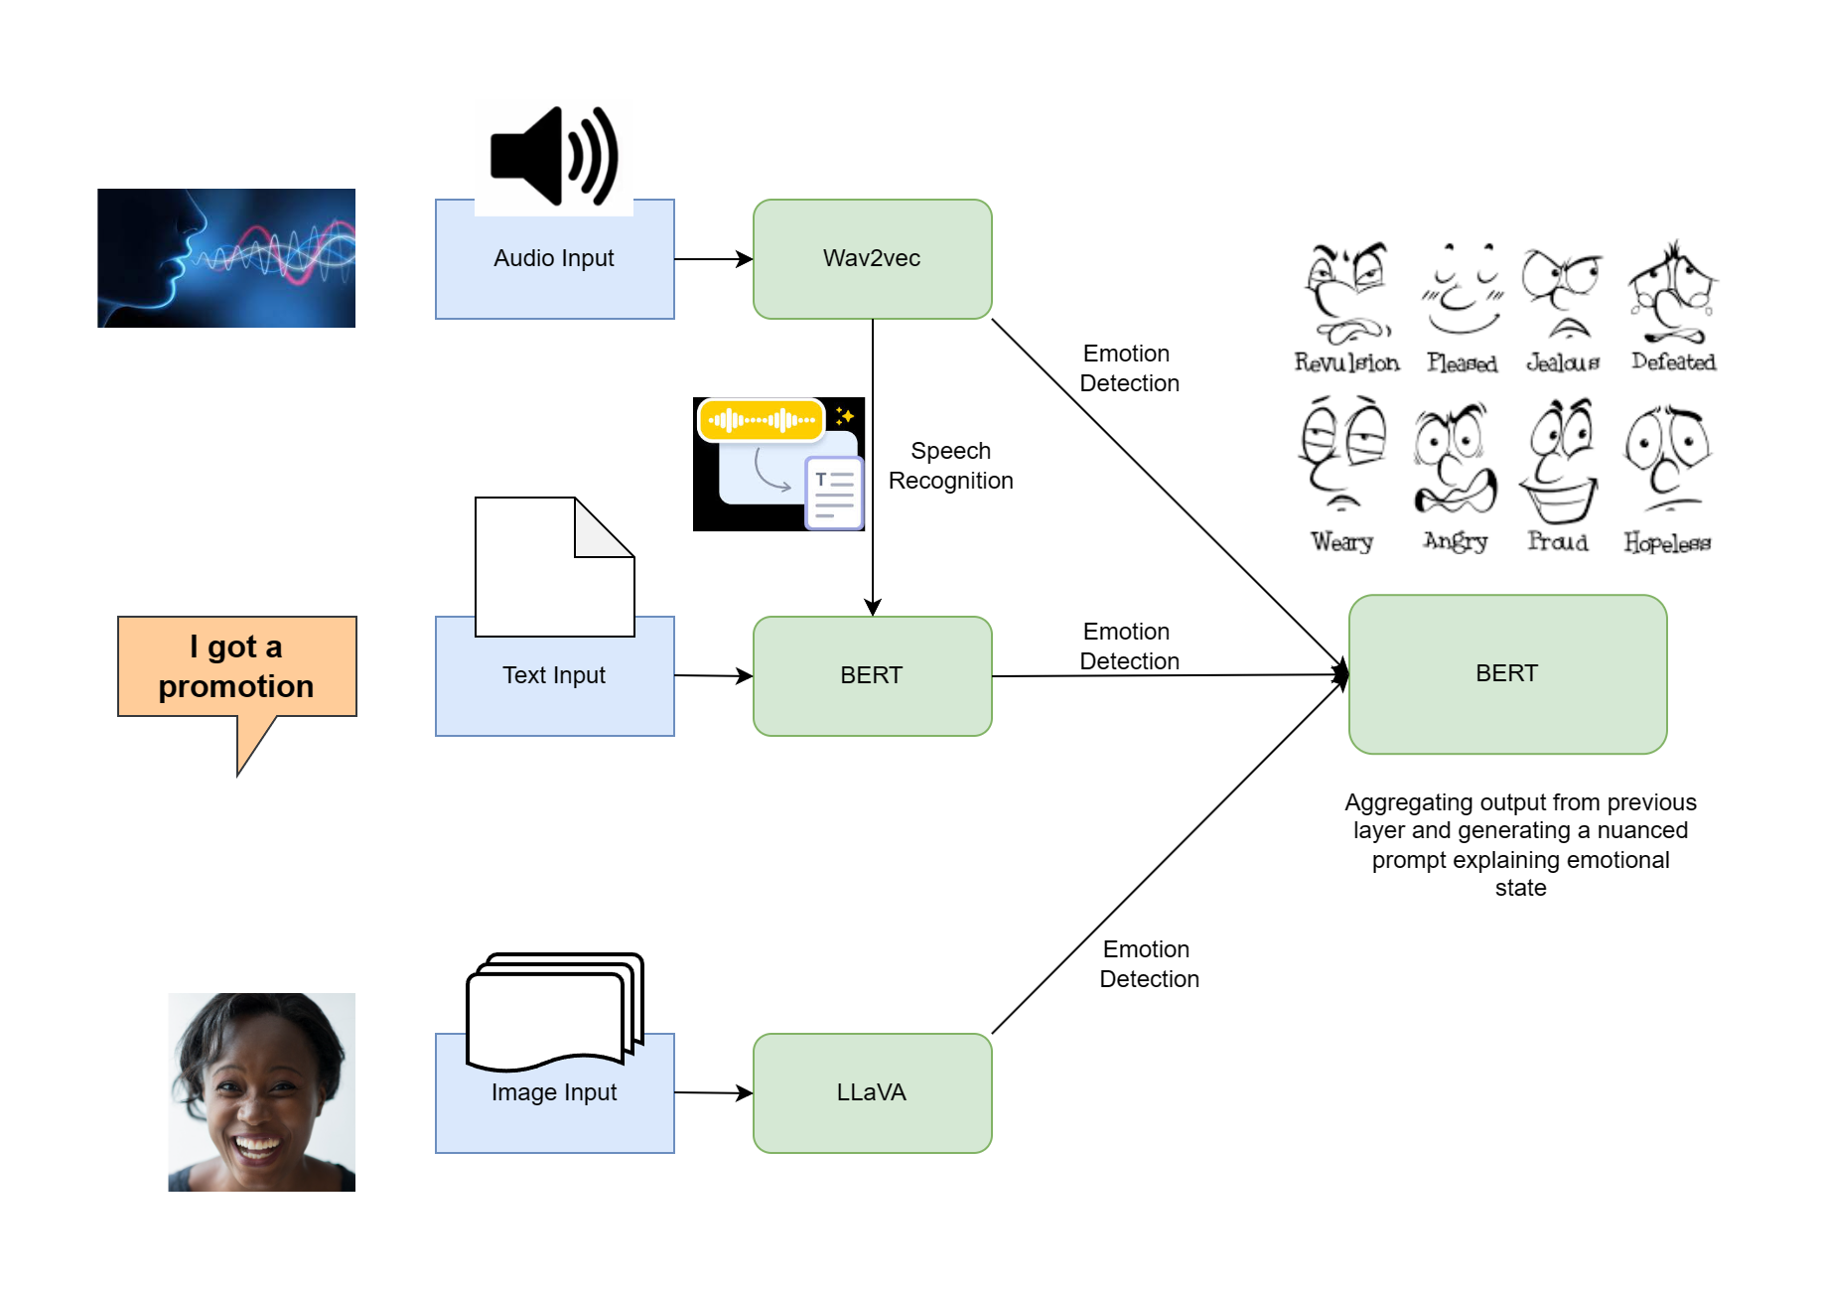
Model Diagram

Slide 13
Data Cleaning and Transformation:
Voice Input:
Resampling by reducing the frequency of the data
Zero padding to have consistent audio length
Converting audio into text using Wav2vec model
Text input:
Feature extraction using the BERT model
Image input:
Augmenting the data
Feature extraction using the LLaVA model

Slide 14
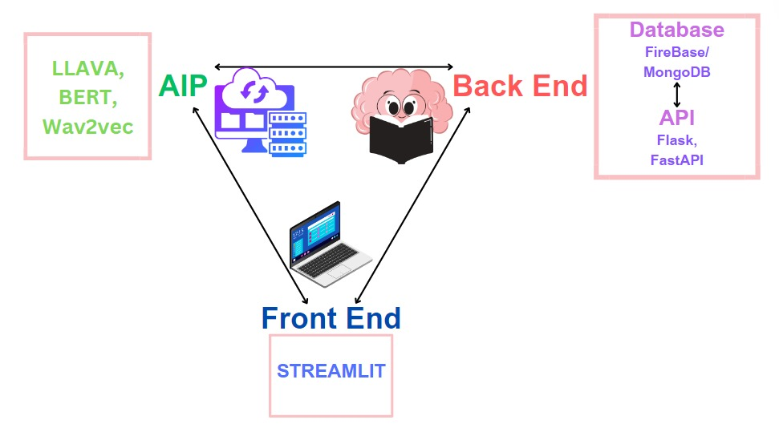
Design of EmotiSense:

Slide 15

LLMs (Large Language Models):
BERT: This model will be primarily used for textual data analysis.
Wav2vec: This model is crucial for audio data analysis. It will be used to process and understand speech patterns, tonality, and other auditory cues indicative of emotional states.
LLaVa: This model will be primarily used for visual data analysis and image processing.
A significant aspect of our data sourcing strategy involves the integration of these modalities. We will develop a framework to synchronize data from text, audio, and image sources, ensuring that they can be effectively combined for multimodal analysis.

Slide 16
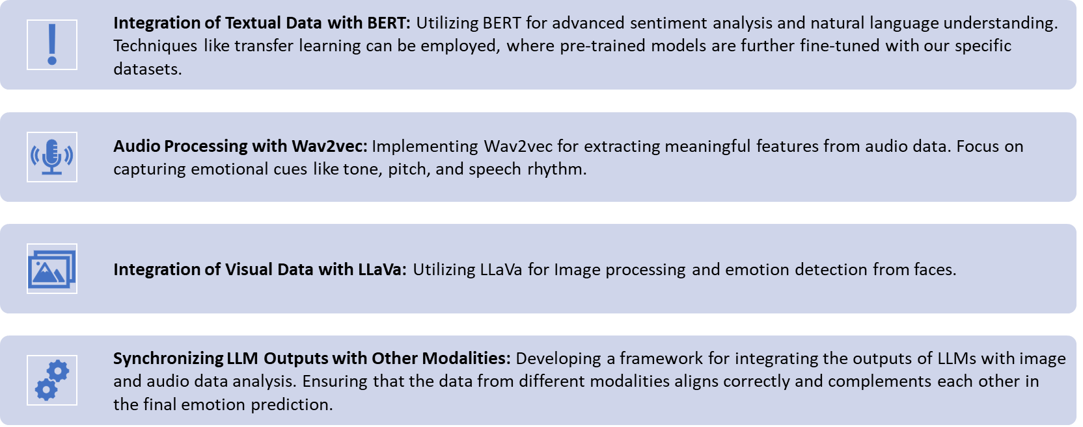
Model Implementation:

Slide 17
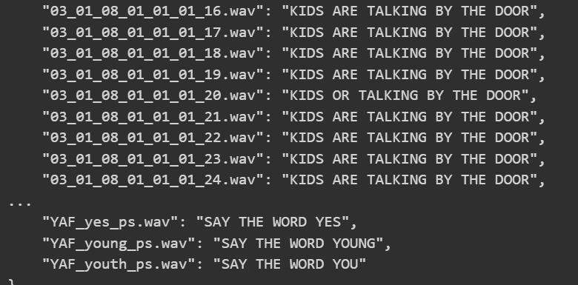
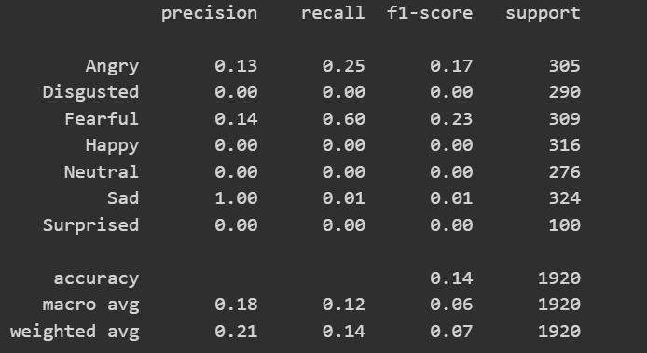
Initial Results
Converting the audio file and extracting the features and transforming them into the text
Testing classification with no fine-tuning

Slide 18

Classification layers of Wav2vec model:

Slide 19
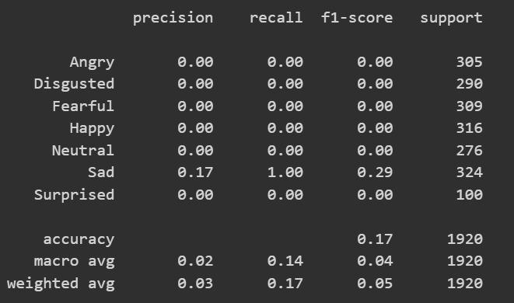
Results with fine-tuning

Slide 20

Roadmap
Augmentation of the data
Improve Wav2vec model performance
Improve the BERT model performance
Implementing the LLaVa model
Fine tuning all models and connecting together

Slide 21
Thank You!

